Slide 1
Program Mapping
A Powerful Tool for Aligning College Programs with Powerful Learning Outcomes and Accreditation Standards
Steve Atkins, Vice President of Academic and Student Affairs at Edison State College
Pam Mangene, Coordinator of Academic Services and Director of Faculty and Staff Development at Edison State College

Slide 2
Session Outcomes
Gain a general understanding of mapping
Describe briefly at least three uses for mapping
Use mapping to demonstrate quality by adhering to external standards of excellence
Develop outcomes – Mapping programs – start with the “end in mind”

Slide 3
Questions
Do you understand student course-taking patterns?
Do you understand the progression of required and elective courses and skill and concept development?
Do faculty ever discuss the level at which individual courses really are taught?
When you propose a course, can you successfully advocate to a curriculum committee what the course contributes to the whole?
What do your students say about gaps in learning opportunities?

Slide 4
What is Mapping?
Produces a picture of a curriculum or program created when you apply a variety of “lenses” as analysis tools
Can be simple or intricate
Provides a basis for targeted collaboration regarding a curriculum or program

Slide 5
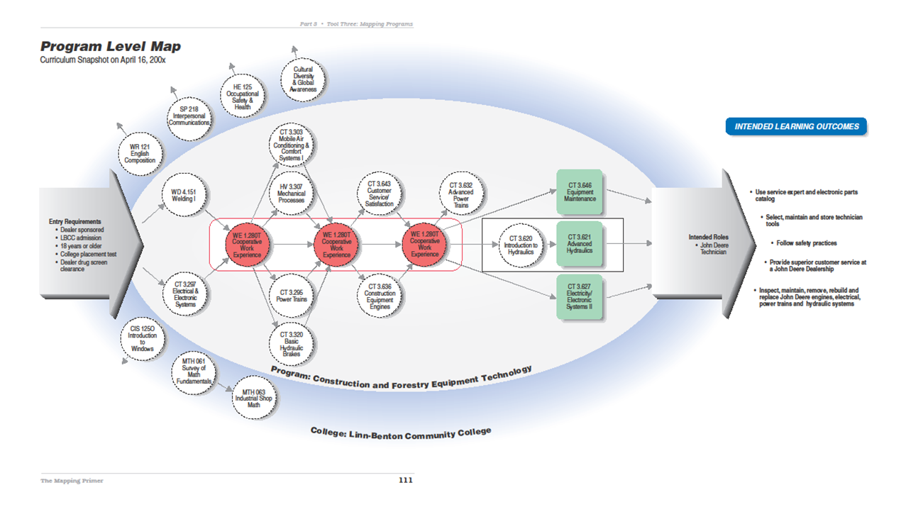
Program Level Map

Slide 6
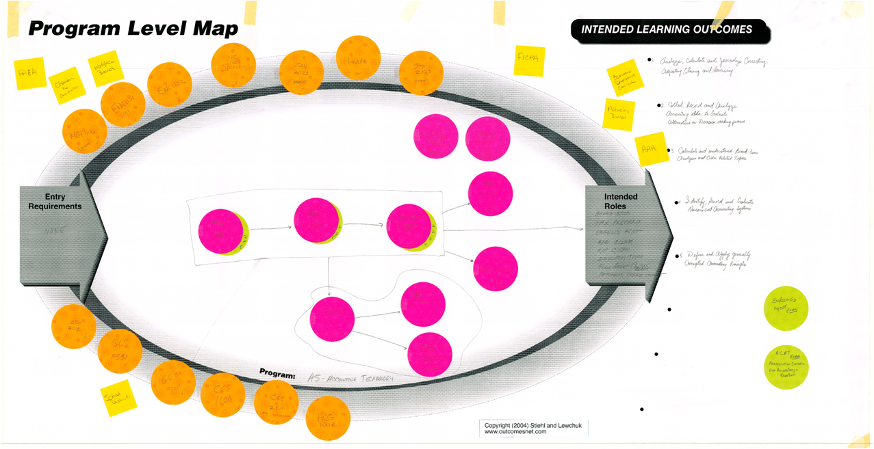
AS – Accounting Technology

Slide 7
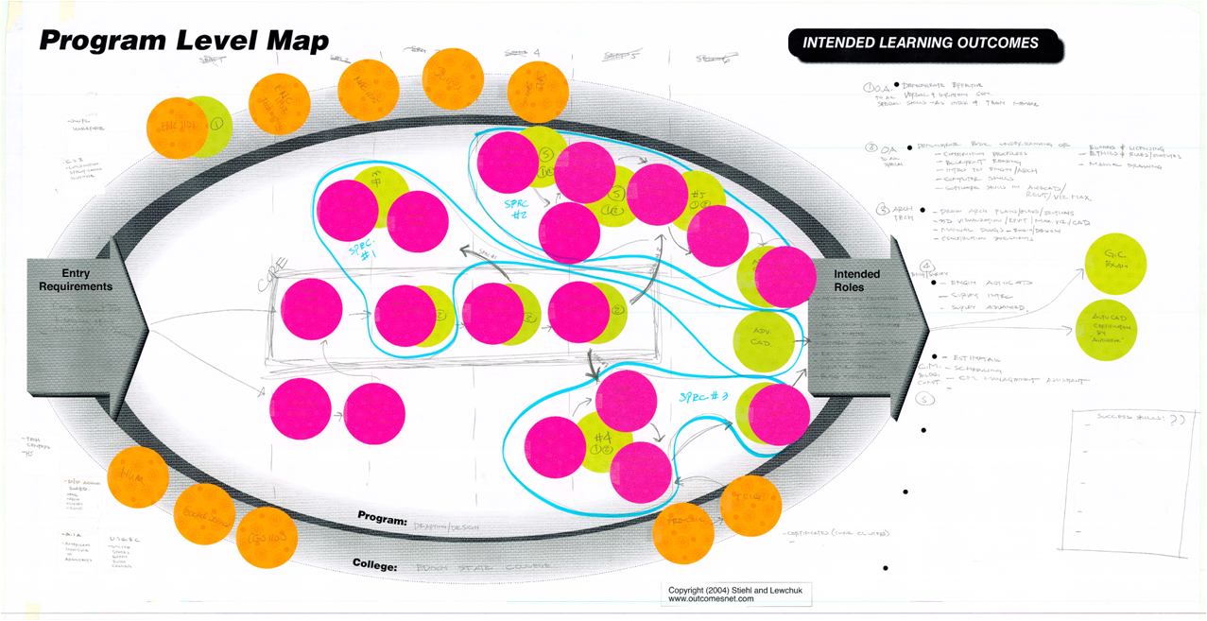
Drafting

Slide 8
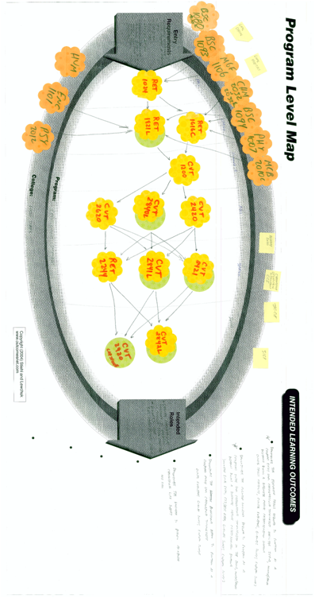
Cardiovascular Technology

Slide 9
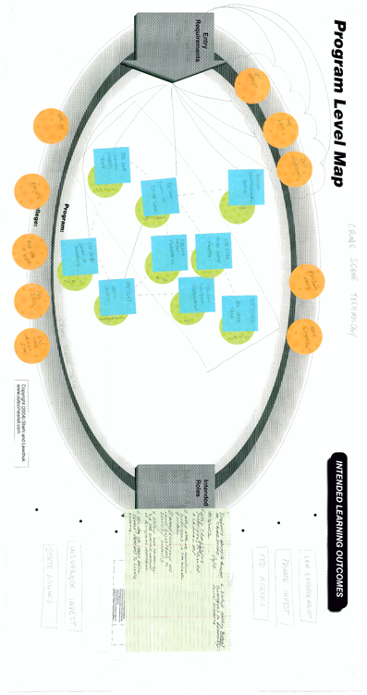
Crime Scene Technology

Slide 10
Management and Supervision:
Curriculum Map (Program Level Outcomes)
Course or Experience | Analysis Approach | Graduates understanding of economics and business… | Graduates application of HR engagement principles… | Graduates application of marketing principles…
Intro to Business Management (us 100) | SLO Addressed | Yes | Yes | Yes
Security Awareness for Managers (Bus 106) | SLO Addressed
Business protocol (Bus 110) | SLO Addressed |  | Yes
Principles of Supervision I (BUS111) | SLO Addressed |  | Yes
Principles of Supervision II (BUS112) | SLO Addressed |  | Yes
Entrepreneurship (BUS 116) | SLO Addressed | Yes
Leadership Development (BUS 117) | SLO Addressed |  | Yes
Concepts Supervision (BUS 118) | SLO Addressed |  | Yes
Business Mathematics I(BUS 121) | SLO Addressed | Yes |  | Yes
Business Mathematics II (BUS 122) | SLO Addressed | Yes |  | Yes
Small Business Management (BUS 165) | SLO Addressed | Yes | Yes | Yes
WEAVEonline: Assessing Achievement on Institutional Missionhttp://www.weaveonline.com/PHPages/wp-content/uploads/2010/04/Newsletter_Spring_2010.pdf#page=2

Slide 11
Management and Supervision:
Curriculum Map (Levels of Instruction)
Course or Experience | Analysis Approach | Graduates understanding of economics and business… | Graduates application of HR engagement principles… | Graduates application of marketing principles…
Intro to Business Management (us 100) | Level of Instruction | 1 Introduced | 1 Introduced | 1 Introduced
Security Awareness for Managers (Bus 106) | Level of Instruction
Business protocol (Bus 110) | Level of Instruction |  | 2 Reinforced
Principles of Supervision I (BUS111) | Level of Instruction |  | 2 Reinforced
Principles of Supervision II (BUS112) | Level of Instruction |  | 3 Emphasized
Entrepreneurship (BUS 116) | Level of Instruction | 1 Introduced
Leadership Development (BUS 117) | Level of Instruction |  | 2 Reinforced
Concepts Supervision (BUS 118) | Level of Instruction |  | 2 Reinforced
Business Mathematics I(BUS 121) | Level of Instruction | 2 Reinforced |  | 2 Reinforced
Business Mathematics II (BUS 122) | Level of Instruction | 2 Reinforced |  | 2 Reinforced
Small Business Management (BUS 165) | Level of Instruction | 3 Emphasized | 3 Emphasized | 3 Emphasized
WEAVEonline: Assessing Achievement on Institutional Missionhttp://www.weaveonline.com/PHPages/wp-content/uploads/2010/04/Newsletter_Spring_2010.pdf#page=2

Slide 12
Management and Supervision:
Curriculum Map (General Education Outcomes)
Course or Experience | Analysis Approach | Communi-cations | Quantitative literacy | Critical Thinking | SQR
Intro to Business Management (us 100) | SLO Addressed | Yes | Yes | Yes
Security Awareness for Managers (Bus 106) | SLO Addressed | Yes |  | Yes | Yes
Business protocol (Bus 110) | SLO Addressed | Yes | Yes | Yes
Principles of Supervision I (BUS111) | SLO Addressed | Yes | Yes | Yes
Principles of Supervision II (BUS112) | SLO Addressed | Yes | Yes | Yes
Entrepreneurship (BUS 116) | SLO Addressed | Yes |  | Yes | Yes
Leadership Development (BUS 117) | SLO Addressed | Yes | Yes | Yes
Concepts Supervision (BUS 118) | SLO Addressed | Yes | Yes
Business Mathematics I(BUS 121) | SLO Addressed | Yes | Yes | Yes
Business Mathematics II (BUS 122) | SLO Addressed | Yes | Yes | Yes
Small Business Management (BUS 165) | SLO Addressed | Yes | Yes | Yes
WEAVEonline: Assessing Achievement on Institutional Missionhttp://www.weaveonline.com/PHPages/wp-content/uploads/2010/04/Newsletter_Spring_2010.pdf#page=2

Slide 13
Management and Supervision:
Curriculum Map
Course or Experience | Analysis Approach | Graduates understanding of economics and business… | Graduates application of HR engagement principles… | Graduates application of marketing principles…
Intro to Business Management (us 100) | Direct Measures of learning SLO Addressed | Standard test
 | Level of Instruction | Introduced
 | Modes of Instruction | Faculty lecture
Small Business Management (BUS 165) | Direct Measures of Student Learning | Student Portfolios * authentic assessment
 | Level of Instruction | Emphasized
 | Modes of Instruction | Lecture – problem based learning
WEAVEonline: Assessing Achievement on Institutional Missionhttp://www.weaveonline.com/PHPages/wp-content/uploads/2010/04/Newsletter_Spring_2010.pdf#page=2

Slide 14
Utilization Maps
For Professional/Accreditation Standards
Course or Experience | Analysis Approach | Apply math, science, and engineering principles | Design and conduct experiments | Design a system, component or processes for needs | Function on multi-disciplinary teams | Identify, formulate, and solve engineering problems
Introduction to Aerospace (AERO 201) | ABET Program Outcomes | Yes/Addressed
Aerospace mechanics (Aero 211) | ABET Program Outcomes | Outcome A | Outcome B |  |  | Outcome E
Thermodynamics for Aerospace (AERO 212) | ABET Program Outcomes | Outcome A | Outcome B |  |  | Outcome E
Material Science for Engineers (AERO 213) | ABET Program Outcomes | Outcome A |  | Outcome C | Outcome D | Outcome E
Engineering Principles of Continuum Mechanics (AERO 214) | ABET Program Outcomes | Outcome A |  |  | Outcome D
Introduction to Aerospace Computation (AERO220) | ABET Program Outcomes | Outcome A |  | Outcome C
Special Topics in… (AERO 289) | ABET Program Outcomes | Outcome A |  | Outcome C |  | Outcome E
Research (Aero 291) | ABET Program Outcomes | Outcome A | Outcome B |  | Outcome D | Outcome E
WEAVEonline: Assessing Achievement on Institutional Missionhttp://www.weaveonline.com/PHPages/wp-content/uploads/2010/04/Newsletter_Spring_2010.pdf#page=2

Slide 15
Developing Student Learning Outcomes

Slide 16
Business Before
Identify, classify, and demonstrate management activities
Evaluate promotional effectiveness
Demonstrate basic understanding of legal and ethical issues
Analyze and develop written solutions to behavior problems affecting job performance
Demonstrate knowledge of the principles and procedures of management
Demonstrate knowledge of budget principles and interpret budgets
Develop and modify marketing mixes for a business
Describe activities associated with the management functions and planning, organizational leadership controls
Identify major acts and important regulations resulting from the growth and changes in financial institutions

Slide 17
Business After
Make strategic management choices including marketing solutions
Ethical decision – making and problem solving
Utilize basic budget knowledge to determine appropriate management choices
Evaluate and select maximizing information technology solutions
Select operational choices that optimize human and capital resources

Slide 18
Accounting Before
Identify, classify, and demonstrate management activities.
Demonstrate a basic understanding of legal and ethical issues in a business environment
Demonstrate knowledge of the principles and practices of management
Demonstrate knowledge of budget principles and interpret budgets
Analyze and develop written solutions to behavior problems affecting job performance
Describe activities associated with the management functions of planning, organizing, staffing, leading, and controlling
Identify major acts and important regulations resulting from the growth and changes in financial institutions.
Develop and modify marketing mixes for a business
Evaluate promotional effectiveness

Slide 19
Accounting After
Development, organization and maintenance of financial records in order to prepare statements in conformity and awareness of GAAP.
Apply the accounting perspective in the business decision making process.
Use break even analysis to evaluate appropriate business issues.
Apply cost accounting processes to capture product and service costs
Use IRS regulations to prepare and review basic individual and corporate tax returns

Slide 20
Nursing Before
Demonstrate skills required to work at the professional RN level
Show leadership skills within the parameters of the Associate Degree nurse.
Show the integration of the physical sciences, behavioral sciences, technology, psychological sciences with pathophysiology and the care of the patient in a clinical setting.
State and demonstrate the professional legal and ethical parameters of the RN.

Slide 21
Nursing After
Perform a comprehensive assessment of the physical, psychosocial, environmental needs of the individual
Recognize the human response to various issues within the individual health care spectrum
Create a plan of care utilizing a multidisciplinary approach that meets the needs of the individual and their support system
Implement safe, competent and compassionate care
Evaluate the individual response to nursing care and modify care to assist the individual achieve the highest quality of life

Slide 22
Defining Program Level Student Learning Outcomes (SLO)
Student learning outcomes describe specific behaviors that a student should demonstrate after having completed your program.
SLO statements should focus on the expected abilities, concepts, values and attitudes of a student after the completion of your program.
SLO statements address roles students take in society and what students will be doing in these roles when they complete your program

Slide 23
Competencies Are Not Outcomes
Competencies consist of miniscule tasks the student will have to demonstrate for a grade
Competencies often reflect trivial and disconnected tasks – based on behavioral psychology framework
Outcomes framework focuses on meaningful tasks (projects) that require synthesis
A good learning outcome is likely to encompass several levels of learning.

Slide 24
Competency Examples
Explain what is meant by over prescription
Contrast behavioral and cognitive learning theories

Slide 25
Guidelines for Writing Student Learning Outcome Statements
SLO statements should be aligned with mission statements (and goals if applicable).
SLO statements should clearly indicate the level and type of competence that is required of graduates of a program.
SLO statements should be distinctive.
SLO statements should not be bundled (require more than one assessment to measure the outcome).

Slide 26
Guidelines for Writing Student Learning Outcome Statements (Cont’d)
SLO statements should focus on the results of learning and not the learning processes.
SLO statements should be stated such that the outcome can be measured by more than one assessment method.
SLO statements should use concrete verbs like define, classify, operate, formulate, rather than passive verbs like be exposed to or vague verbs like understand, know.

Slide 27
Developing Program Level Learning Outcomes
Prepare a set of outcomes statements describing what students should be able to do when they leave ESC. Lots of work already exists in the area of skill sets and standards, accreditation requirements, previous course outlines, SCANS, brochures and catalogue descriptions, curriculum committee reports, learning objectives or outcomes developed for a similar unit at another institution, professional organization standards or recommendations.

Slide 28
Examples of Intended Program Outcomes (Stiehl, 2002)
Apply management concepts to effectively manage projects and project teams in a high technology lab…
Manage a caseload for a state division of children’s services…
Demonstrate community leadership in resolving environmental hazards and issues…
Survey and analyze business needs to determine how telecommunications can provide solutions…
Use your understanding of social theory to develop effective urban committees/agendas…

Slide 29
Building SLOs: Four Major Components
Identification of fundamental and powerful concepts, skills, or abilities
A description of what the student will be able to do (behavior) (verb + type of thinking or activity is important here)
The conditions under which the students will perform the task (will determine level of cognitive complexity - What tools, references, or other aids will be provided or denied should be make clear)
The criteria (intellectual standards)for evaluating student performance

Slide 30
Simple LO –
Fundamental Concept – Standard Deviation
Condition – Given a set of data from a representative sample of a well-defined population
Behavior – the student will be able to compute the standard deviation, make valid inferences, and identify relevant assumptions
Criterion- (implied) – number computed will be accurate and inferences will be logical, relevant, clear, and precise.

Slide 31
Statements Should Be Neither too Specific or too General
For example, if a university’s Education Department were writing statements…
TOO SPECIFIC:
“Students will be able to compose true/false statements.”
TOO GENERAL:
“Students will be able to prepare a good test.”
MORE APPROPRIATE:
“Students will be able to utilize alternative forms of evaluation in classroom teaching situations.” (adapted from University of Central Florida, UCF Academic Program Assessment Handbook 2004)

Slide 32
Example of a Generic Outcome:
Students completing the AS in Architectural Design will be practiced in design skills.

Slide 33
Example of a Distinctive Outcome:
AS graduates in Architectural Design will demonstrate general design principles; use fundamental engineering techniques, skills, and tools for architectural design practice; and analyze and interpret data to produce meaningful conclusions and recommendations.
Seattle Central Community College: Curriculum Coordinating Council
http://seattlecentral.edu/users/crc/Assessment/IA_Writing_Course_Outcomes.htm

Slide 34
Analysis of Outcomes:
You Be the Judge…
POOR: Students completing the undergraduate program in Hypothetical Engineering will have knowledge of engineering principles.
WHY?
This is a weak statement because it does not specify which engineering principles a graduate from the program should know. Also, it does not define what is meant by “have knowledge.” Are they supposed to be able to simply define the principles, or be able to apply the principles, etc.
Seattle Central Community College: Curriculum Coordinating Council
http://seattlecentral.edu/users/crc/Assessment/IA_Writing_Course_Outcomes.htm

Slide 35
Analysis of Outcomes
BETTER: Graduates will be competent in the principles of engineering design, formulating requirements and constraints, following an open-ended decision process involving tradeoffs, and complete a design addressing an aerospace engineering need.
WHY?
This statement is better because it lists the specific areas in hypothetical engineering that a student must be competent in. However, it is still vague, as the level of competency is not stated. Are they expected to understand these concepts or apply them, etc.

Slide 36
Analysis of Outcomes
BEST: Graduates will be able to apply and demonstrate the principles of engineering design, formulating requirements and constraints, following an open-ended decision process involving tradeoffs, completing a design addressing an aerospace engineering need.
WHY?
This is a much better learning outcome statement for two reasons. First, the specific requirements are listed and second, the level of competency is also stated. A student must be able to apply and to demonstrate the listed engineering principles.

Slide 37
Analysis of Outcomes
POOR: PhD students of Educational Research Methods will be successful in their research.
WHY?
This statement is very vague and provides no indication of what “successful” means. It does not specify what type or quality of research skills is expected from the student.

Slide 38
Analysis of Outcomes
BETTER: PhD students of Educational Research methods will be successful in conducting high-quality research.
WHY?
Although the quality of research expected from the doctoral students is identified, there is no indication of specific research capabilities that a student should possess. Therefore, even though it provides more detail than the previous statement, it is still lacking.

Slide 39
Analysis of Outcomes
BEST: Ph.D. graduates of ERM are able to conduct high-quality, doctoral research as evidenced by their demonstrated results, dissertations, publications, and technical presentations.
WHY?
What is expected of a doctoral student in this program are clearly defined and stated making this an effective learning outcome statement. The quality of research expected as well as the specific research requirements are articulated in the outcome statement.

Slide 40
Analysis of Outcomes
POOR: Students should know the historically important systems of psychology.
WHY?
This is poor because it says neither what systems nor what information about each system students should know. Are they supposed to know everything about them or just names? Should students be able recognize the names, recite the central ideas, or criticize the assumptions?

Slide 41
Analysis of Outcomes
BETTER: Students should understand the psychoanalytic, Gestalt, behaviorist, humanistic, and cognitive approaches to psychology.
WHY?
This is better because it says what theories students should know, but it still does not detail what exactly they should know about each theory, nor how deeply they should understand whatever it is they should understand.
University of Connecticut: Assessment
http://assessment.uconn.edu/docs/HowToWriteObjectivesOutcomes.pdf

Slide 42
Analysis of Outcomes
BEST: Students should be able to recognize and articulate the foundational assumptions, central ideas, and dominant criticisms of the psychoanalytic, Gestalt, behaviorist, humanistic, and cognitive approaches to psychology.
WHY?
This is the clearest and most specific statement of the three examples. It provides even beginning students an understandable and very specific target to aim for. It provides faculty with a reasonable standard against which they can compare actual student performance.

Slide 43
Analysis of Outcomes
POOR: Students should be able to independently design and carry out research.
WHY?
The problem with this is that the statement does not specify the type or quality of research to be done.

Slide 44
Analysis of Outcomes
BETTER: Students should be able to independently design and carry out experimental and correlational research.
WHY?
This specifies the type of research, but not the quality students must achieve. If a student independently does any research that is experimental or correlational, it would be viewed as acceptable.

Slide 45
Analysis of Outcomes
BEST: Students should be able to independently design and carry out experimental and correlational research that yields valid results.
WHY?
Here the standard for students to aim for is clear and specific enough to help faculty agree about what students are expected to do. Therefore, they should be able to agree reasonably well about whether students have or have not achieved the objective. Even introductory students can understand the sentence, even if they don’t know exactly what experimental and correlational research methods are.

Slide 46
Now… You Write the Outcomes
Come up with one to three outcomes that summarize what students will be able to do as a result of completing your program

Slide 47
Course Level Outcomes
Course level outcomes require the same components as program level outcomes; however, the focus on what students should be able to do when they leave your course.
Identification of fundamental and powerful concepts (skills or abilities)
A description of what the student will be able to do (verb + type of thinking or activity is important here)
The conditions under which the students will perform the task (will determine level of cognitive complexity - What tools, references, or other aids will be provided or denied should be make clear)
The criteria (intellectual standards)for evaluating student performance

Slide 48
Sample Course Outcome
Fundamental Concept or Skill: Students will be able to write a research paper.
Criterion: Students will be able to write a research paper in the appropriate scientific style.
Condition: At the end of their field research, students will be able to write a research paper in the appropriate scientific style.
Behavior: Students will be able to do research.

Slide 49
Examples Of Course Level Outcomes
Here are two samples:
Demonstrate accurately the addition of sine waves using physical devices, instrumentation, and graphs.
Use physical and chemical properties to accurately determine the quality of paper samples and make meaningful recommendations based on specific requirements.
League for Innovation: Istream http://www.league.org/istreamSite/lens_index.cfm?gr=yes&visible=block

Slide 50
Course Level Outcomes
TOO BROAD:
Students will demonstrate knowledge of the history, literature and function of the theatre, including works from various periods and cultures.
BETTER:
Students will be able to explain the theoretical bases of various dramatic genres and illustrate them with examples from plays of different eras.
BEST:
During the senior dramatic literature course, the students will be able to explain the theoretical bases of various dramatic genres and illustrate them with examples from plays of different eras.
University of Connecticut: Assessment
http://assessment.uconn.edu/docs/HowToWriteObjectivesOutcomes.pdf

Slide 51
SLO
TOO BROAD:
The student will be able to discuss philosophical questions.
BETTER:
The student is able to develop relevant examples and to express the significance of philosophical questions

Slide 52
SLO
TOO BROAD:
Students will understand how to use technology effectively.
BETTER:
Each student will be able to use word processing, spreadsheets, databases, and
presentation graphics in preparing their final research project and report.

Slide 53
Compare Your Answers
Consider the following outcome statements. Based on what you've just read, which of the following meet the criteria listed above, and which need to be revised or totally rewritten? Compare your answers to ours.

Slide 54
Compare Your Answers
Understand Newton's three laws of motion.
Show Answer
"Understand" is not an action word and does not describe what students will be able to do differently as a result of the course. A better outcome might be: Use Newton's three laws of motion to predict motion in three dimensions.
League for Innovation: Istream http://www.league.org/istreamSite/lens_index.cfm?gr=yes&visible=block

Slide 55
Compare Your Answers
Appreciate the difference between various forms of graphical representation.
Show Answer
This statement is vague and is not measurable. A better outcome might be: Given a set of data, construct a time series, scatter plot, or histogram to show relationships between quantities.
League for Innovation: Istream http://www.league.org/istreamSite/lens_index.cfm?gr=yes&visible=block

Slide 56
Compare Your Answers
Express numbers in scientific notation using the correct number of significant digits.
Show Answer
This statement describes a discrete skill, but not an overarching goal of a class. A better outcome might be: Express and manipulate numbers effectively using the concepts of scientific notation, significant digits, and SI unit measurements.
League for Innovation: Istream http://www.league.org/istreamSite/lens_index.cfm?gr=yes&visible=block

Slide 57
Compare Your Answers
Diagnose failures in the vacuum, mechanical components, and controls of HVAC systems and determine necessary action for repairs.
Hide Answer
This statement meets all the criteria
League for Innovation: Istream http://www.league.org/istreamSite/lens_index.cfm?gr=yes&visible=block

Slide 58
Compare Your Answers
Identify unknown bacteria using gram stain, biochemical, and other microbiological methods for identification.
Hide Answer
This statement meets all the criteria.
League for Innovation: Istream http://www.league.org/istreamSite/lens_index.cfm?gr=yes&visible=block

Slide 59
Writing SLOs –
Fundamental Concepts and Skills
SLO statements should reflect the most fundamental and powerful concepts of the field.
Definition:
A fundamental and powerful concept is one that can be used to explain or think out a huge body of questions, problems, information, and situations. All fields have F&P concepts, but there are a relatively small number of them in any particular area. They are the most central and useful ideas in the discipline. They are to be contrasted with individual bits of information, or with less general concepts.”

Slide 60
F & P Concepts
“[I]f you can understand the F&P concepts in a deep way, you are in a position to understand a great deal of the rest of the course” (Nosich).
  If a student understands the concept deeply, then is it true that he/she will understand the rest of the discipline more deeply?
  Will focusing on this concept help the student work through any problem or question that arises in the course?

Slide 61
Organizing Your Course Concepts
Using one of the blank charts below, outline the structure of concepts and topics in your course, from the most basic F&P concepts to more specialized and detailed concepts. Create at least three levels.
Copy of Chart 1.doc
Copy of Chart 2.doc

Slide 62
Resources
Richard Paul and Linda Elder’s The Miniature Guide for Those Who Teach on How to Improve Student Learning (2002). Pp. 43-44.
Gerald Nosich’s Learning to Think Things Through: A Guide to Critical Thinking Across the Curriculum (2005). Pearson, Prentice Hall.
Seattle Central Community College: Curriculum Coordinating Council
http://seattlecentral.edu/users/crc/Assessment/IA_Writing_Course_Outcomes.htm
University of Connecticut: Assessment
http://assessment.uconn.edu/docs/HowToWriteObjectivesOutcomes.pdf
League for Innovation: Istream http://www.league.org/istreamSite/lens_index.cfm?gr=yes&visible=block
Ruth Stiehl’s The Outcomes Primer: Reconstructing the College Curriculum (2002). The Learning Organization.
WEAVEonline: Assessing Achievement on Institutional Missionhttp://www.weaveonline.com/PHPages/wp-content/uploads/2010/04/Newsletter_Spring_2010.pdf#page=2

